Slide 1

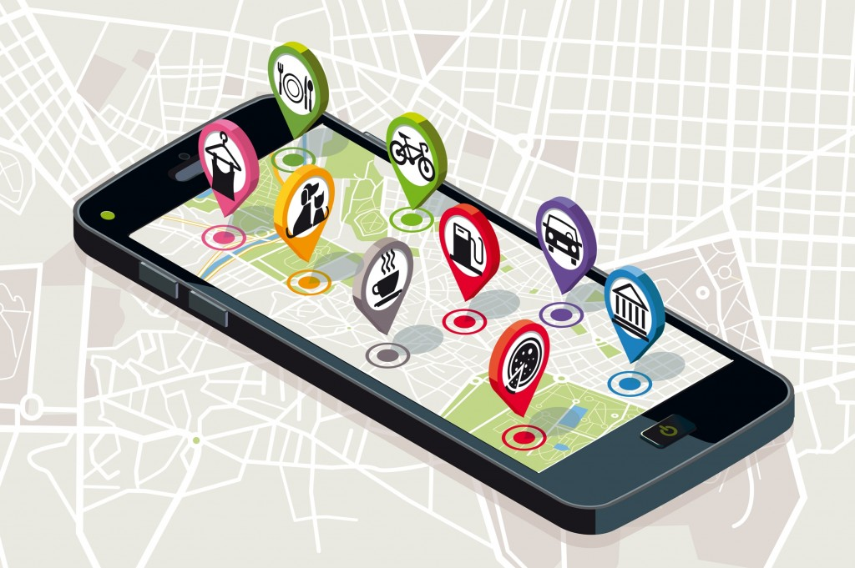
SP
PROJECT
Tride- A Web Application implementing Hass Free Ride Solutions

Slide 2
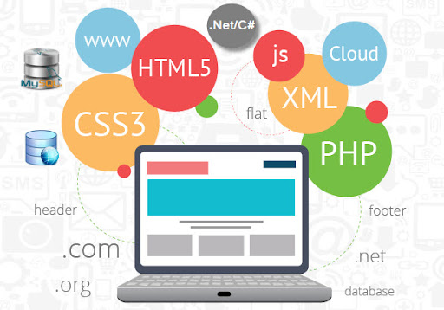
Team:-
GURU PRASAD.N(1941110)
JOGITH BIJU CHUNGATH(1941111)
RAGHAV SHAM KAMAT(1941129)
SWAROOP.P(1941138)
Guide:-
Dr. UMMESALMA M

Slide 3


Our Domain:- Trip Assistant

Slide 4


INTRODUCTION
Apps play an important role in our daily life. Anything we want we can get only with one mouse click. Speed, reliability and accuracy of the app make it a powerful tool for different purposes. A very important and basic need of today’s modern business world is the quick availability and processing of information using apps. One can easily get the type of required information within a fraction of a second. The project that we have taken is also in this category which is used in our daily life whenever we want to plan a trip at the comfort of our house.

Slide 5
OBJECTIVE:-
Tride is a web app which is aimed not only to determine the destinations within the route but also to provide a wide range of facilities to the riders making their journey smooth.The facilities include a summary of desired destinations,suggested stays,motels,garages and places of emergency like hospitals ,all the above mentioned features would be available as menu options ,These options won't restrict the users with itinerary planning, time management finance planning fuel management ,interaction with forums etc. It would also help the users to explore the rate at which you must travel to arrive at your destination, reasonable plan for travel, and cost associated with the travel.With kilometers being an important factor whilst travelling .A major input(kilometer) taken from the user would also give a scheduled break for people travelling so fuel break wouldn't be a problem as it is one of a major concern.

Slide 6
SYSTEM ANALYSIS:-
System Analysis is carried out. It is the process of studying the business processes and procedures, generally referred to as business systems, to see how they can operate and whether the improvement is needed.

Slide 7
Undertaken By | Travelling Assistant | Status
Guruprasad N | About | Completed
Raghav Sham Kamat | Contact | Completed
Swaroop P | Features | Completed
Jogith Biju Chungath | Footer | Completed
Raghav Sham Kamat | Header | Completed
Swaroop P | Navigation Bar | Completed
Guruprasad N | Offers | Completed
Raghav Sham Kamat | Landing Page Integration | Completed
Swaroop P | Login Module | Completed
Jogith Biju Chungath | Registration Module | Completed
Guruprasad N | Forget Password Module | Completed
Swaroop P | Session Time out/ Cache storage | Completed
Raghav Sham Kamat | Fuel Calculator -Trip Entry | Completed
Swaroop P | Fuel Calculator -Vehicle Profile | Completed
Jogith Biju Chungath | Fuel Calculator - Trip History | Completed
Guruprasad N | Fuel Calculator - Past entries | Completed

Slide 8
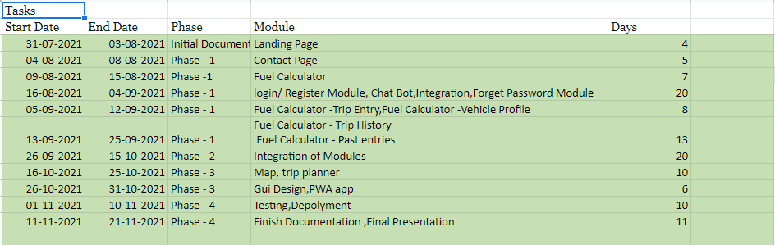
Project Timeline

Slide 9
SOFTWARE REQUIREMENTS
At Developer Side
Software Used
XAMP SERVER
MYSQL Database
ReactJS
HTML
Notepad
Photoshop
At System Users Side
Software Requirements
Browser (IE 7.0 or Above, Mozilla Firefox, Google Chrome
Browser Must be JavaScript Enabled

Slide 10
HARDWARE REQUIREMENTS
At Developer Side
Hardware Used
Intel core i5
4 GB RAM.
O.S. – Windows 10
Anroid 8
At System Users Side
Hardware Requirements
Intel Core i3
O.S. – Windows 10
Anroid 8
IOS 12

Slide 11
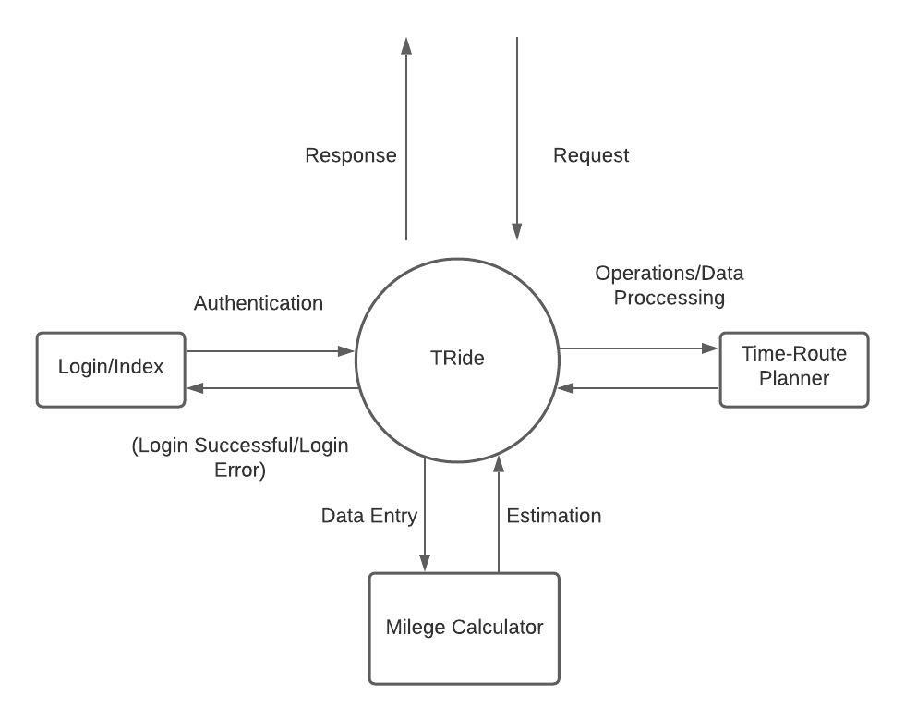
Data Flow Diagram

Slide 12
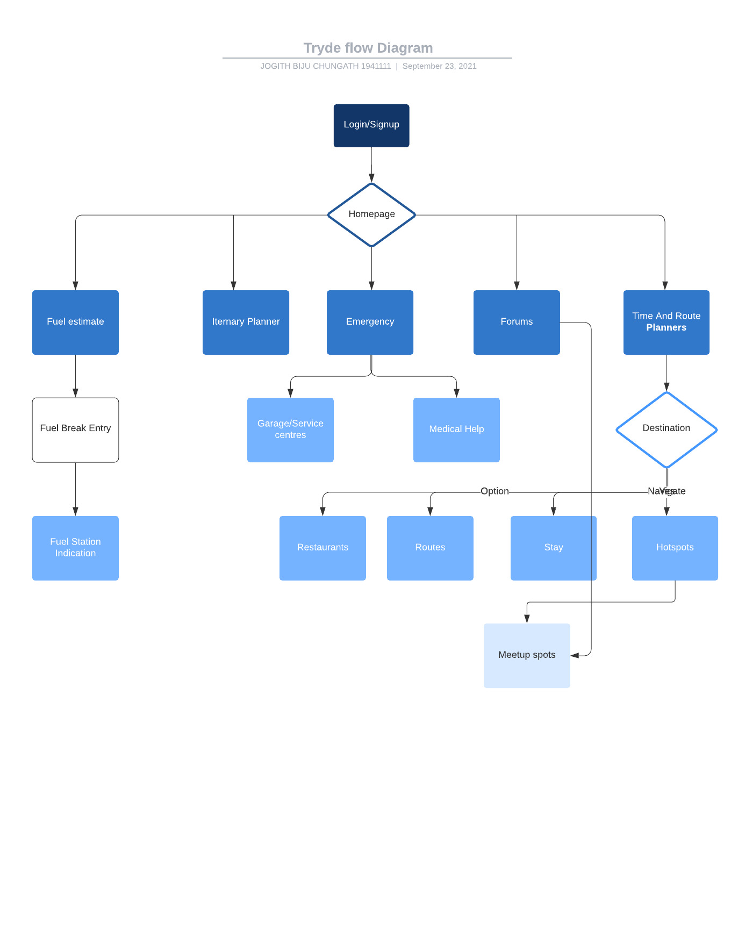
User-Interface(Flow Chart)

Slide 13
Scope of the solution
Identify the responsible user for a new system
Clarify the user request
Identify deficiencies in the current system
Establish goals and objectives for the new system
Determine the feasibility for the new system
Prepare a project charter that will be used to guide the remainder of the Project

Slide 14
NON-FUNCTIONAL REQUIREMENTS
Performance Requirement
The performance of the product mainly depends on the bandwidth of internet connection.
Security Requirements
We aim to provide high security features like encryption to the user accounts to provide security from illegal hacking and gaining access to the system.
Notes:
We have optimixed our page by
Minify CSS, JavaScript, and HTML
Optimize images
Security for passwords md5 encrytion
Ssl security

Slide 15
USER REQUIREMENT
The user requires these features from the proposed system:
Quick generation of Trip Routes
Quick processing of Places to Visit
Quick retrieval of data
Quick and correct updating of data.
Least storage requirements
Secured and controllable data storage
Full backups of data
Readable, clean, up to date and timely reports

Slide 16
Function
Travel and Ride Function
Users can access the information about various places to be visited.
Users can become a member of the site by registering themselves.
Users can als meet co travellers on the way.
Selected categories can be explored by the user
Registered User
Log–in page to log into the application.
Itinerary Planner
Mileage Calculator
Meet Co Travellers
Forums
Can change his/her password
General User
We assume that the user knows English & users need not be computer professionals.
Users should be aware of the internet.
Users can access information through hyperlinks such as navigation of various pages.

Slide 17
Apis Used
Bing Maps Api
Google Sheet Api
Acu Weather Api

Slide 18
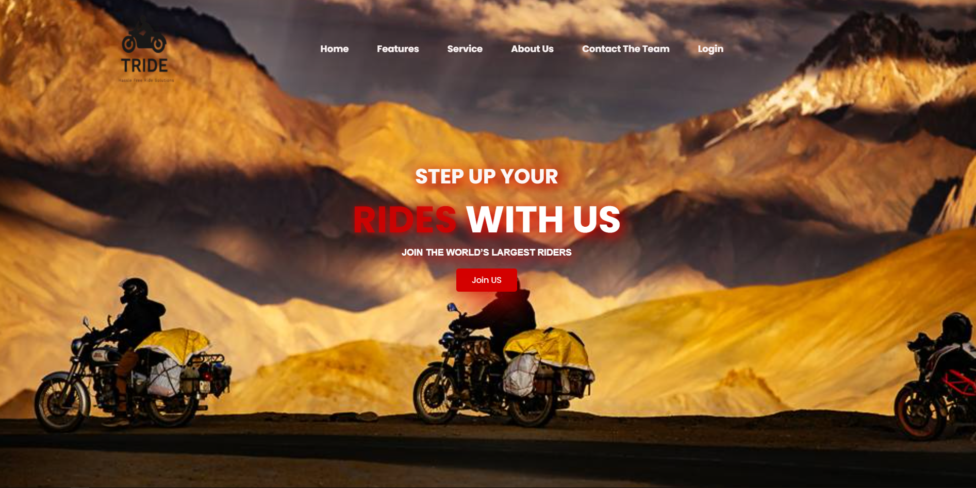
UI-Screenshots-Landing Page

Slide 19
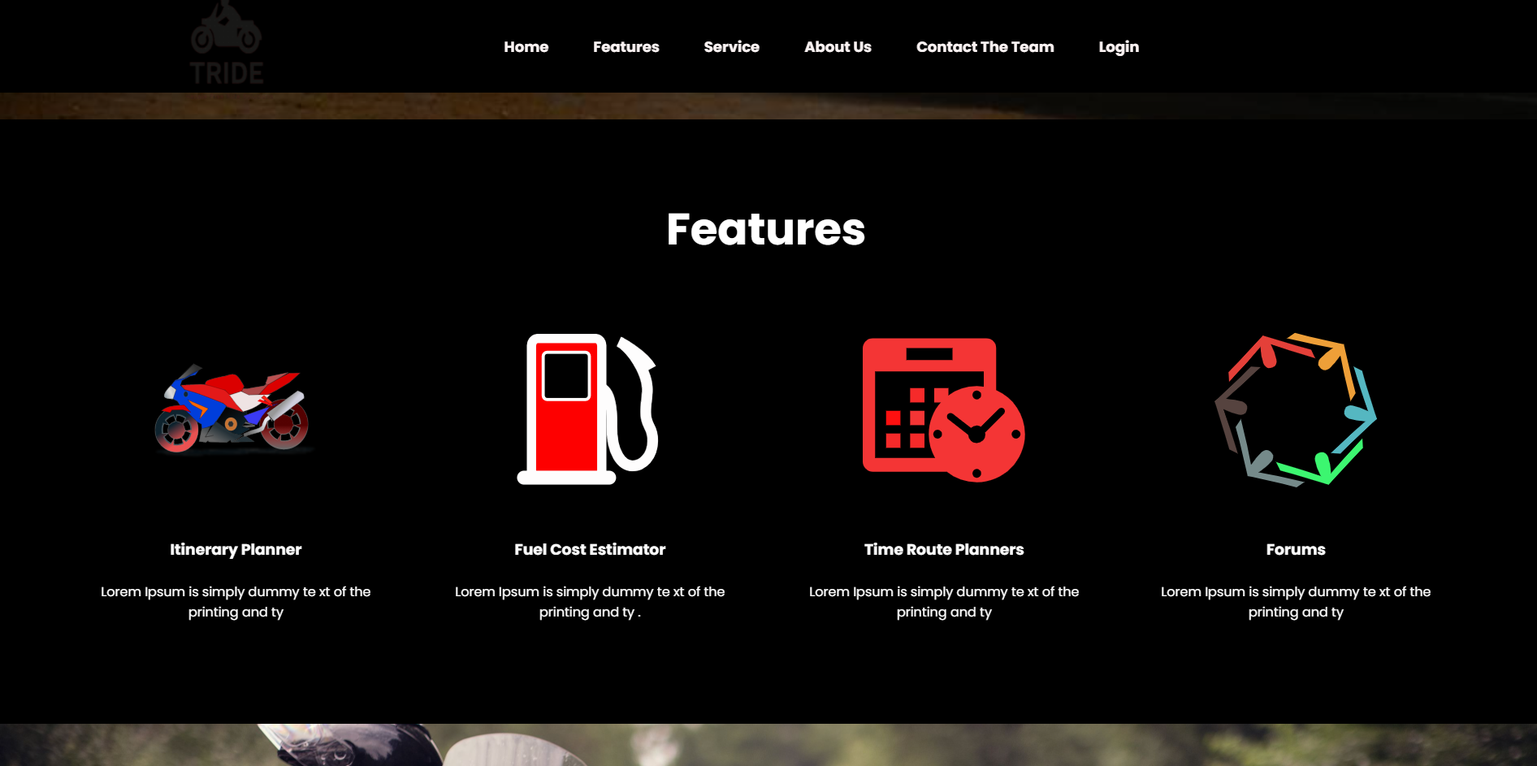
UI-Screenshots-Features/Module

Slide 20
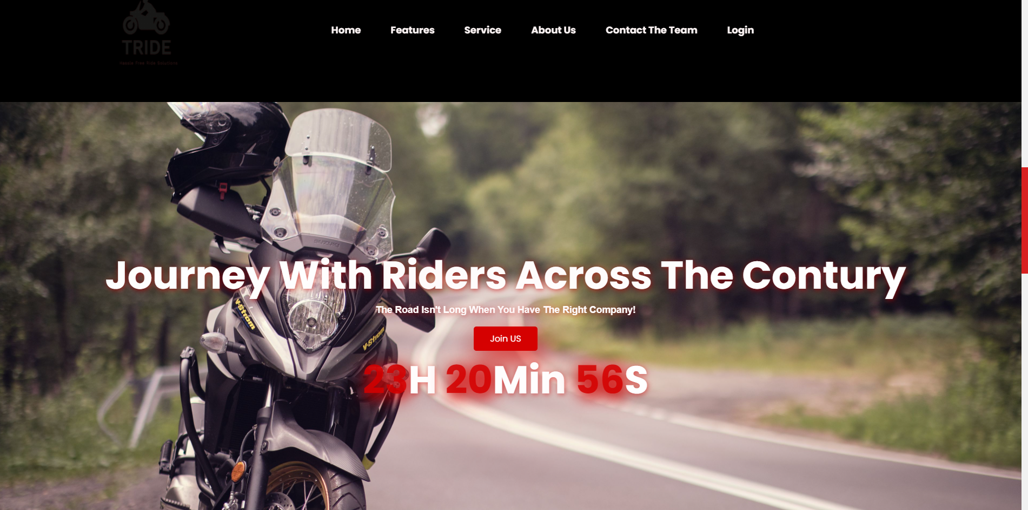
UI-Screenshots

Slide 21
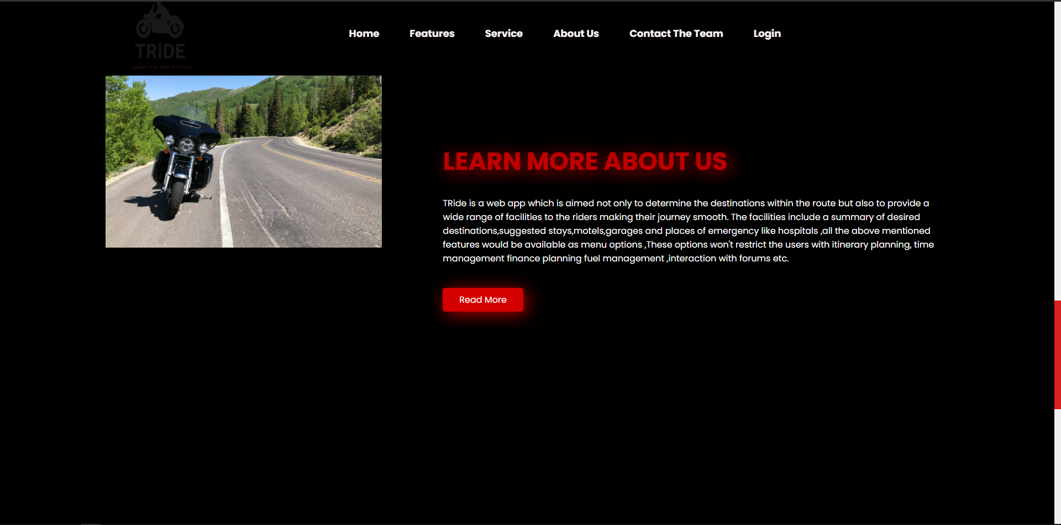
UI-Screenshots/Query

Slide 22
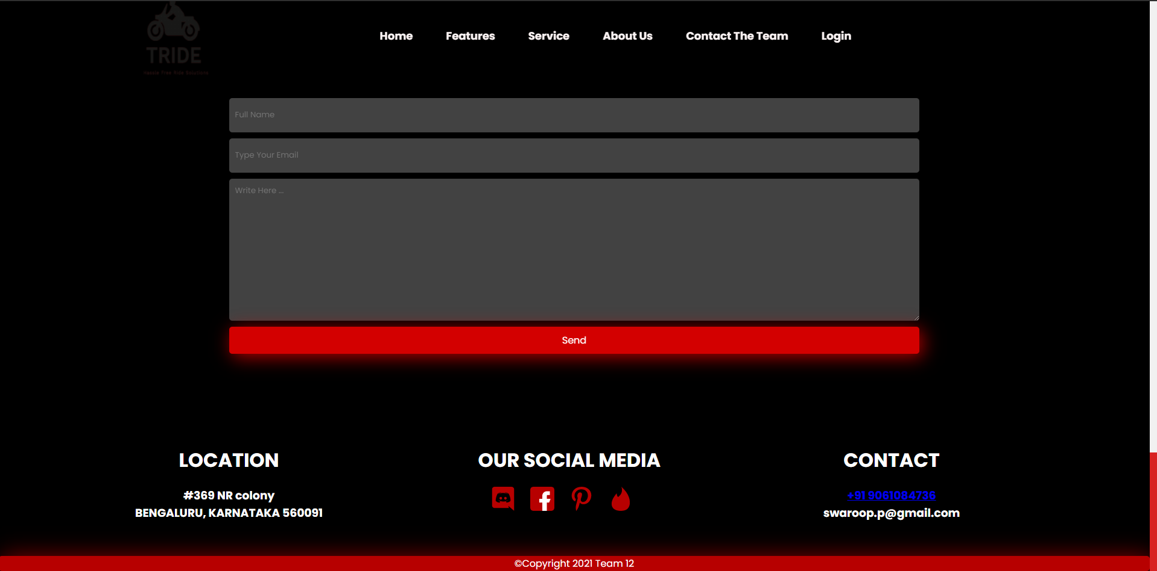
UI-Screenshots-Query Form

Slide 23
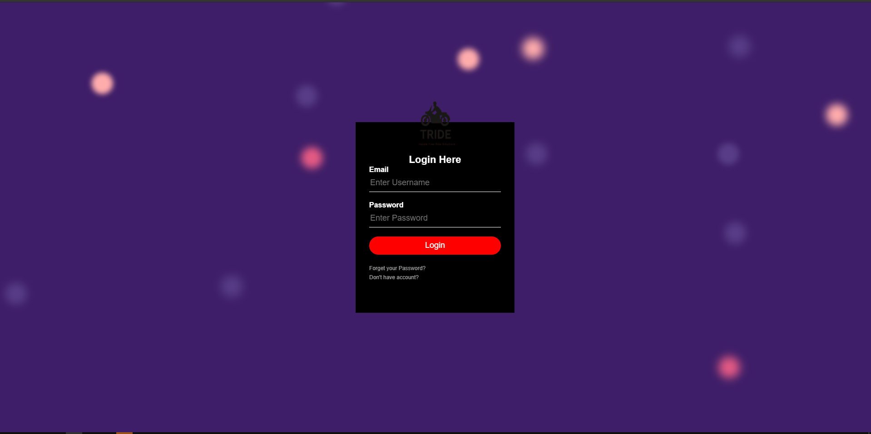
UI-Screenshots-Login Form

Slide 24
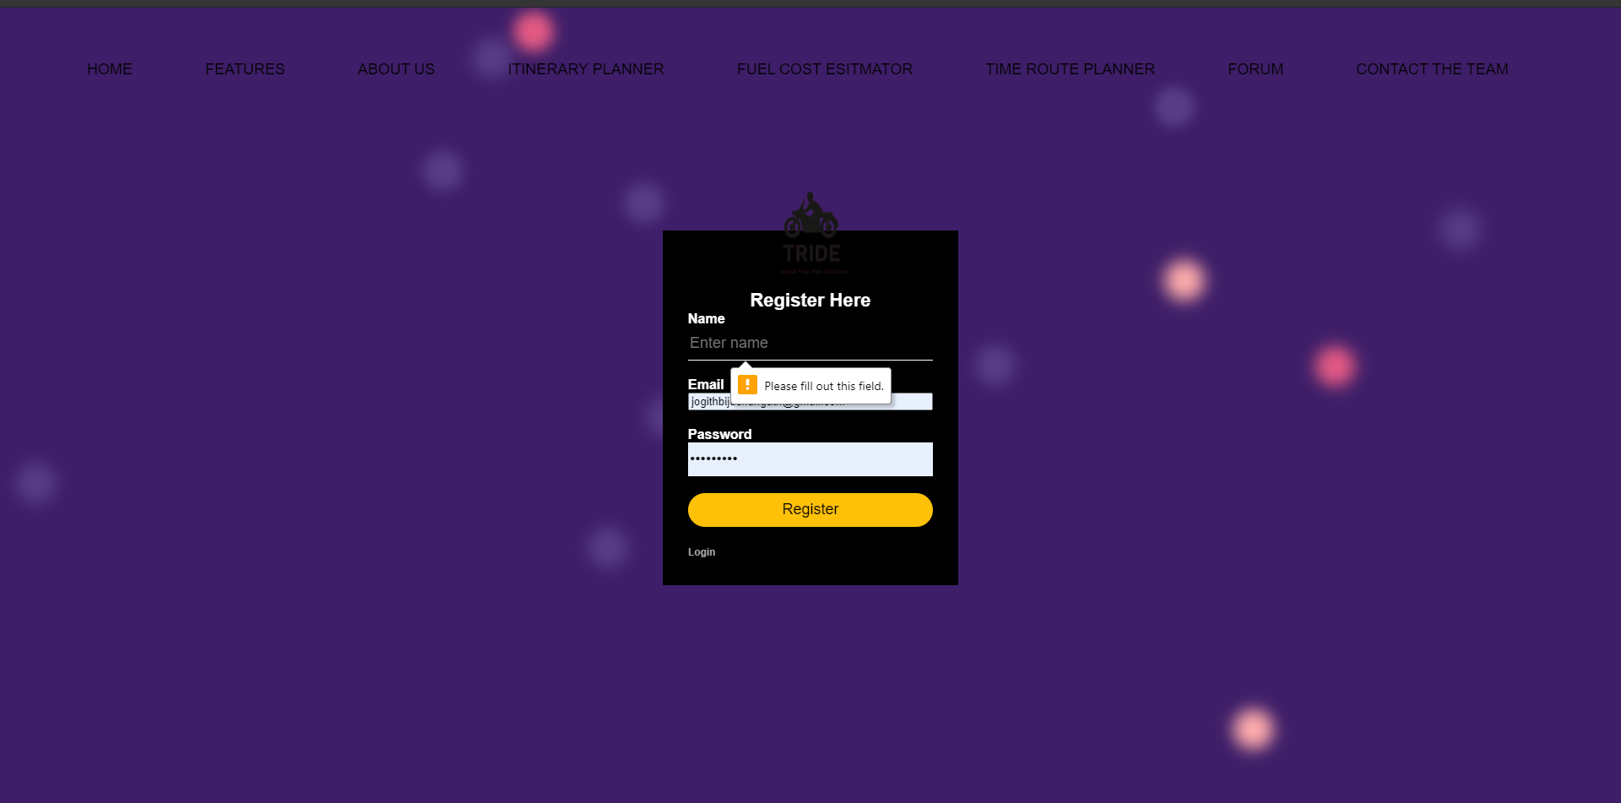
UI-Screenshots-Query Form

Slide 25
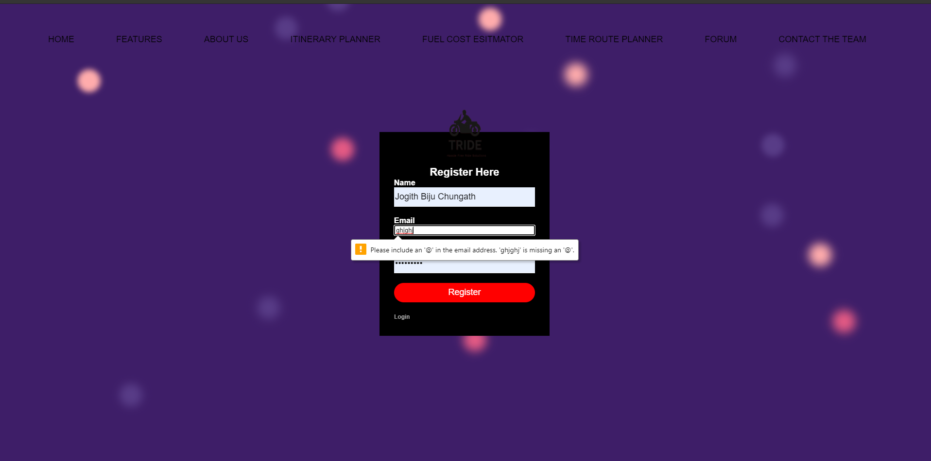
UI-Screenshots-Query Form

Slide 26
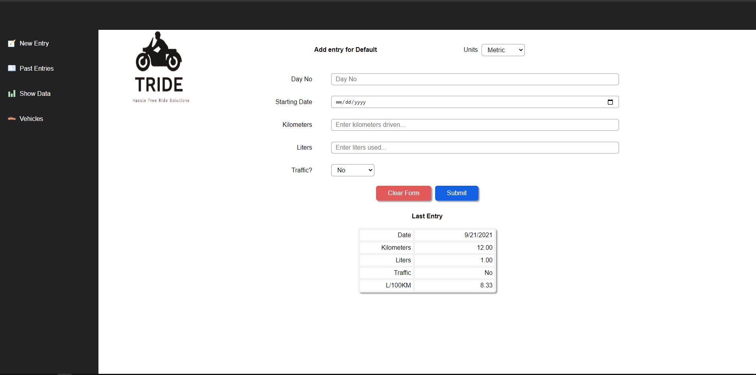
UI-Screenshots-Fuel Calculator

Slide 27
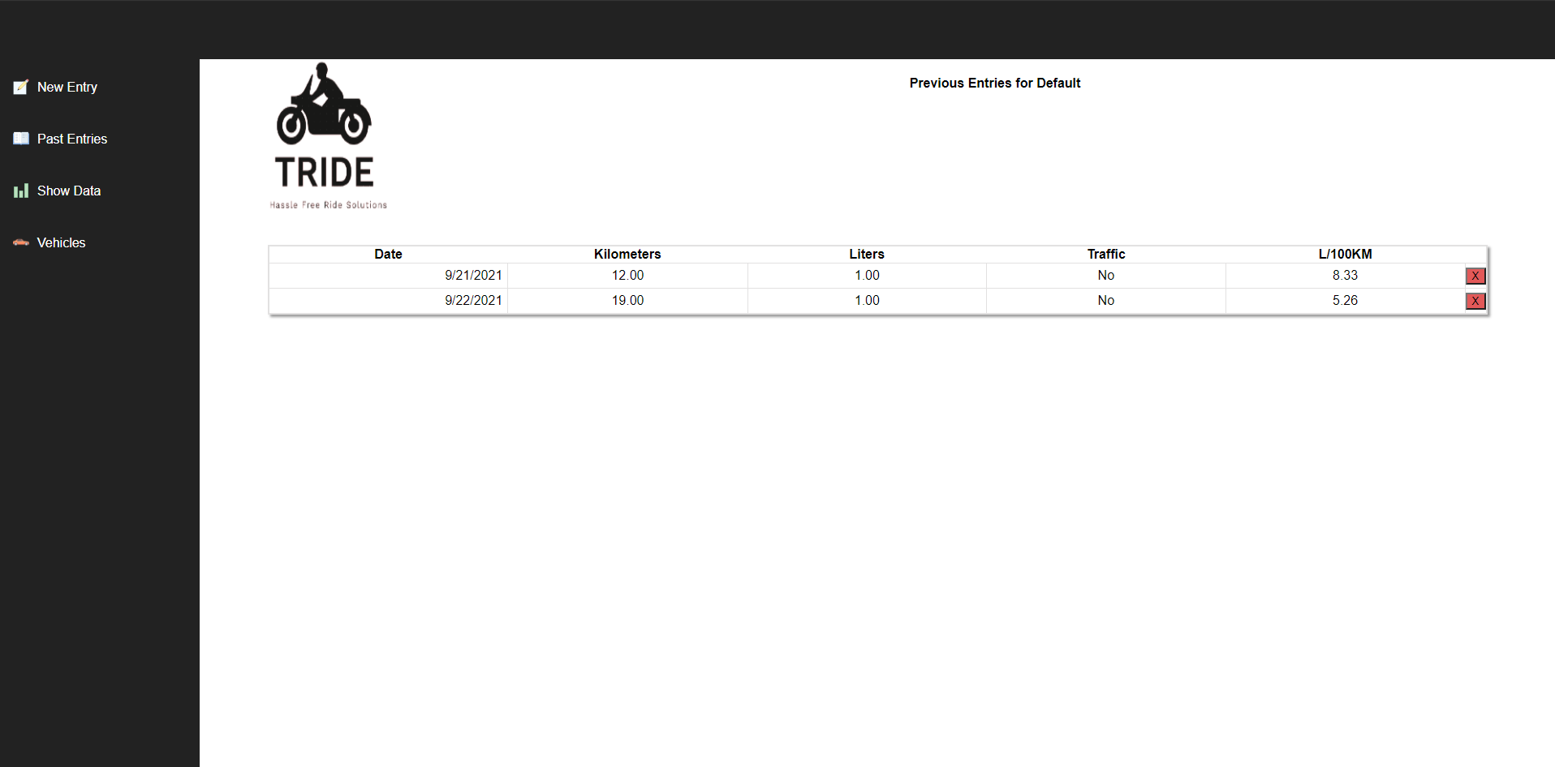
UI-Screenshots-Past Entries

Slide 28
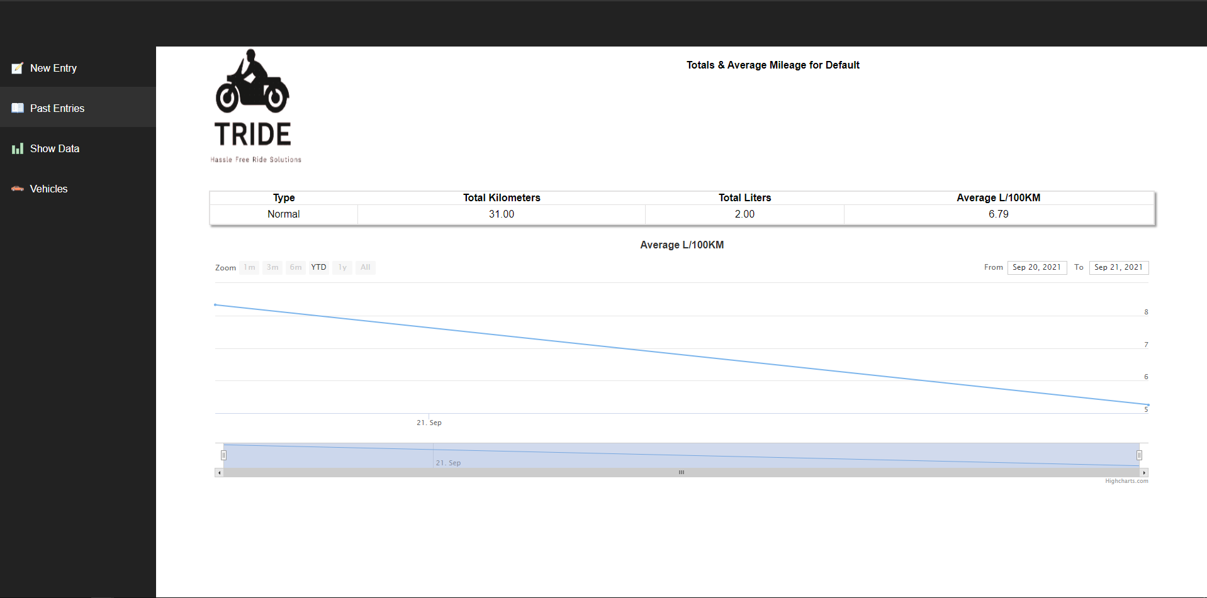
UI-Screenshots-Past Entries Graph

Slide 29
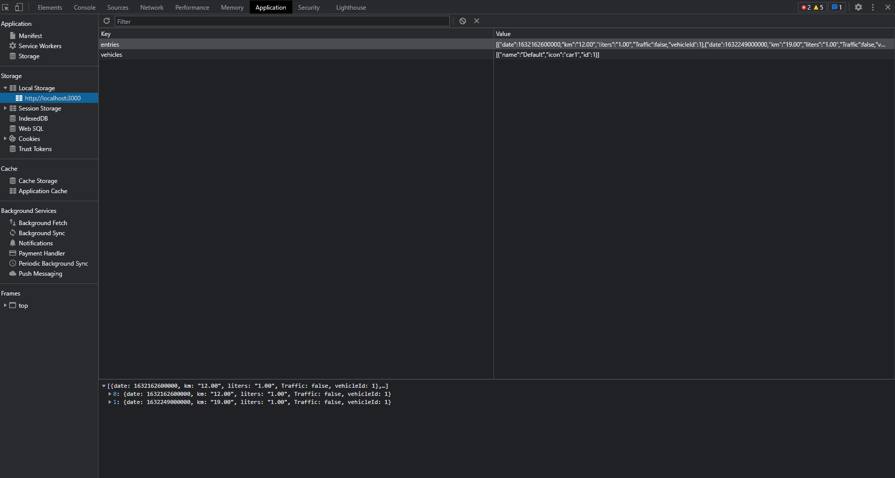
UI-Screenshots-Data Stored In Cache Storage

Slide 30
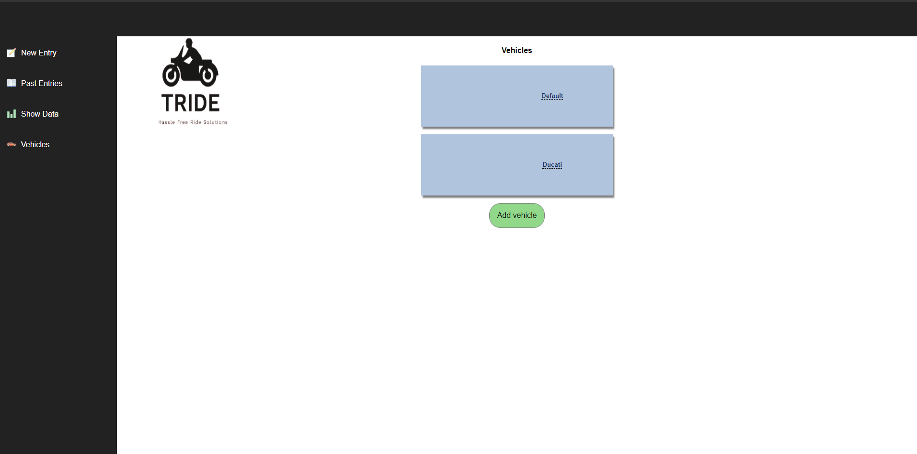
UI-Screenshots-Adding Vehicle

Slide 31
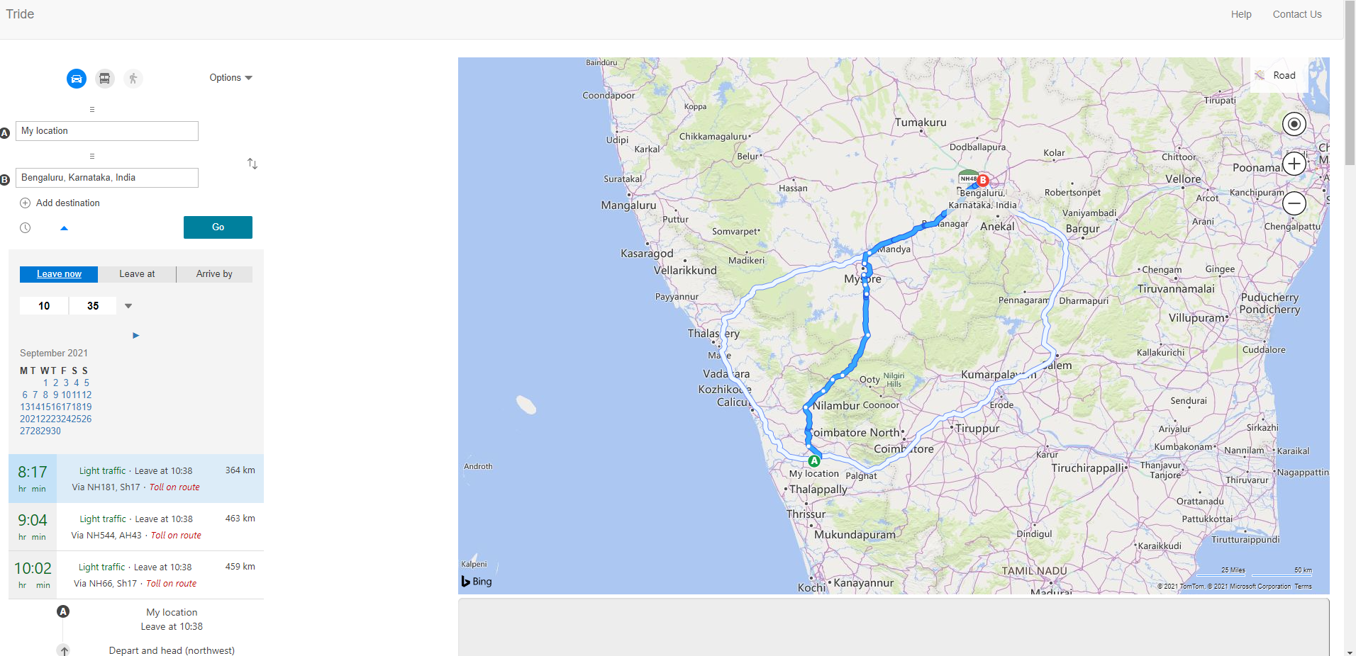
UI-Screenshots-Maps

Slide 32
Thank you..

